Slide 1
LPWAN 2
Denise Yap,
Dominic Heaton,
Pawel Kostkowski,
Samuel Wong

Slide 2
Overview
Project Brief
System Components
LoRa
LoRaWAN
Development
Testing
Demonstration
Notes:
Section breakdown showing who’s doing what:
Project Brief - Dom
System Components - Dom
LoRa - Denise
LoRaWAN - Sam
Development - Dom, Denise, Sam
Testing - Pawel
Demonstration - Dom

Slide 3
Project Brief
Design a Low Power Wireless Area Network (LPWAN) that:
Collects data from various sensors
Transmits the data using the LoRa network
Displays the data on a website
Use Cases of the project:
Noise pollution monitoring in a urban environment
Basic meteorological data collection system
Notes:
Project brief outlined a LPWAN system that needed to do as shown
Two use cases outlined - combined both in the final design

Slide 4
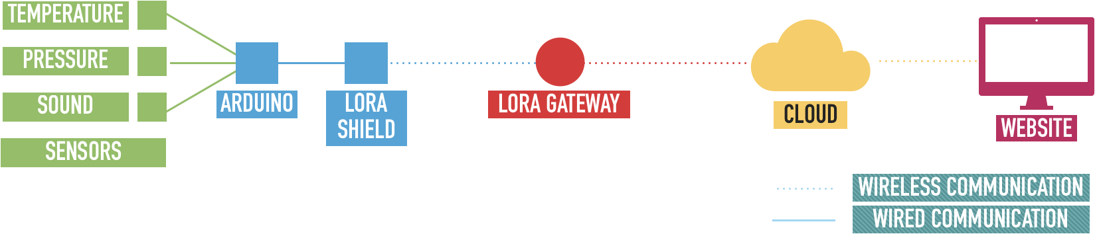
System Components
Notes:
Overview of the system designed for the brief
Sensors pass data to arduino
LoRa to communicate the information to the Cloud
Website to display the data through visuals
At the centre is LoRa - so here’s some background about LoRa

Slide 5
LoRa
LoRa vs. LoRaWAN
LoRa = PHY Layer
LoRaWAN = MAC, NWK and APP build on LoRa.

Slide 6
Some Definitions...
Symbol : discrete RF energy state that represent some quantity of information.
Spreading factor: number of bits encoded per symbol
[7-12] bits per symbol

Slide 7
LoRa’s Proprietary PHY
Modulations: Chirp Spread Spectrum (CSS)
A type of digital modulation.
Define how digital values are mapped into RF energy.
What’s a chirp?
A signal whose frequency continuously increasing or decreasing.
Cyclically-shifted

Slide 8
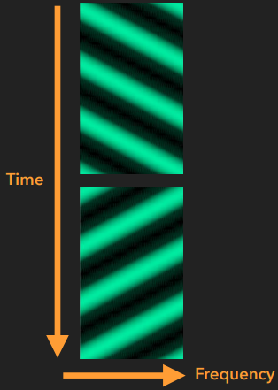
CSS Chirps
Up chirp (top)
Increasing frequency
Down chirp (bottom)
Decreasing frequency

Slide 9
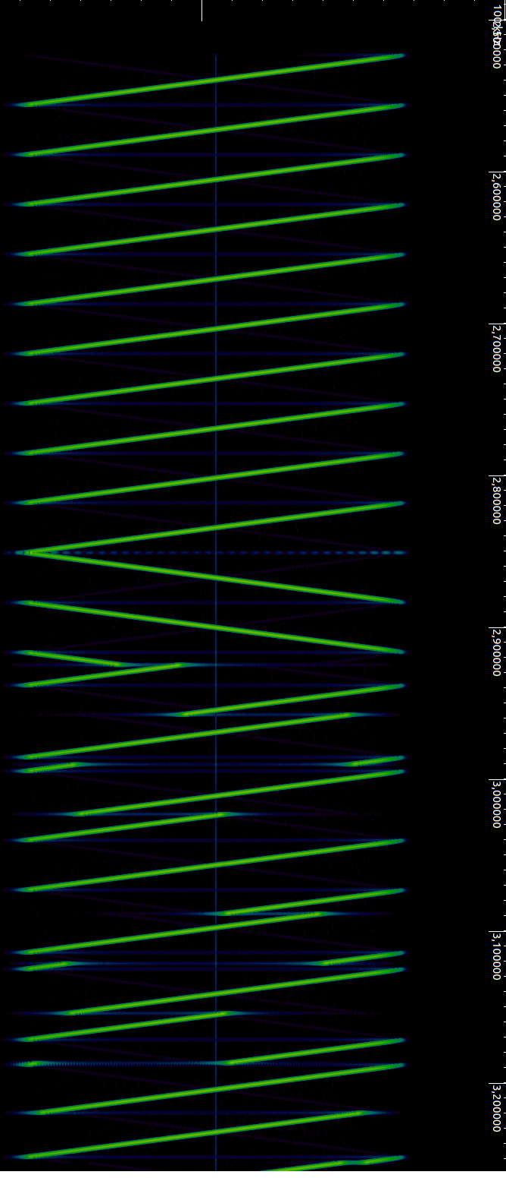
LoRa PHY Frame
Repeated up chirps
Preamble/Training Sequence
Two down chirps
Start of frame delimiter (SFD)
Choppy up chirps of varying length.
Data
1
2
3

Slide 10
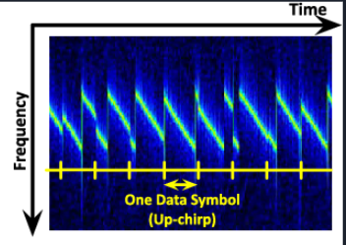
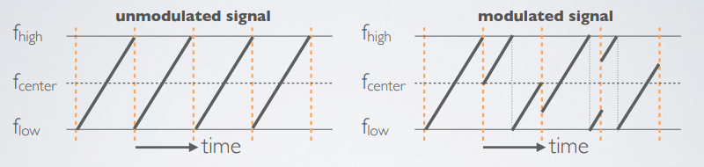
PHY Data Unit Structure
Chirp undergo instantaneous frequency changes and “jump” throughout band.
These are result of data being modulated onto the chirps.
Symbol: a RF energy state that represent some data.

Slide 11
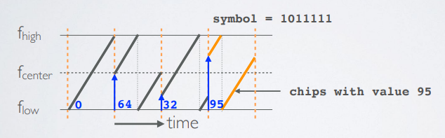
For Example:
Symbol : 1011111 (decimal value = 95)
Spreading Factor : number of bits encoded per symbol.
SF = 7
The sweep signal is divided into 2^SF chips.
2^7 = 128 chips
== chop the sweep signal into 128 pieces and call each piece a chip.
Each sweep arrangement represent a value.

Slide 12
Demodulating the PHY
1
Identify the beginning of a frame.
Find the beginning of the PHY data unit (SFD).
Extract data from instantaneous frequency transitions .
2
3

Slide 13
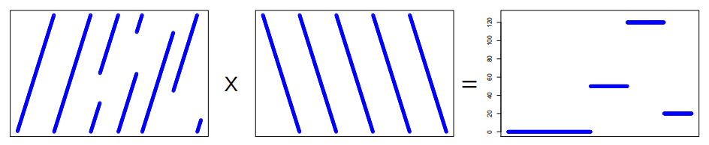
Transforming the Signal
Step 1: De-chirping the signal
While encoding LoRa, we cyclic shift the frequency of the LoRa signal.
So, if we multiply the received 'frequency shifted LoRa chirp' with 'inverse chirp' we will get the constant frequency signal, with a specific frequency characteristic of the transmitted signal.
Step 2: Fast Fourier Transform
Take FFT of de-chirp signal and the symbol can be resolved by finding the argmax, (the strongest component) of each FFT
Received Signal x Inverse chirp = Constant Frequency

Slide 14
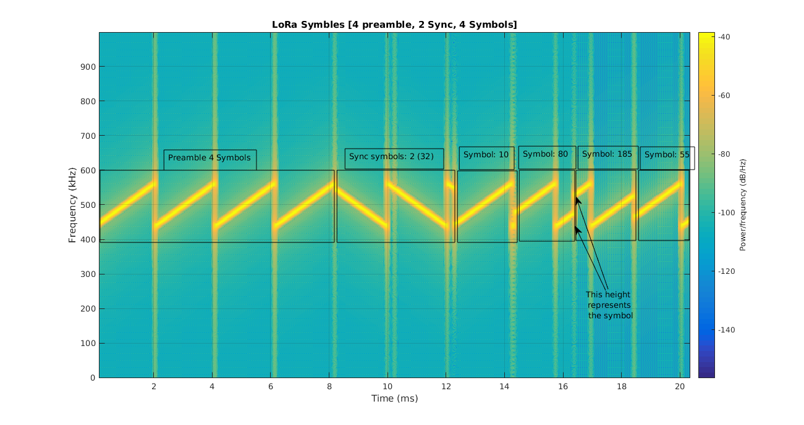
Example
A LoRa packet which has 4 preamble symbols, 2 SFD symbols (32) and 4 message symbols (10,80,185,55) , with SF=8, is shown below:

Slide 15
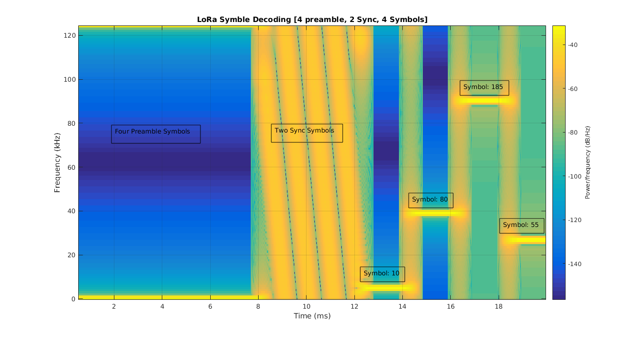
At the receiver side, this message is multiple by inverse chirp and the spectrogram is shown below:

Slide 16
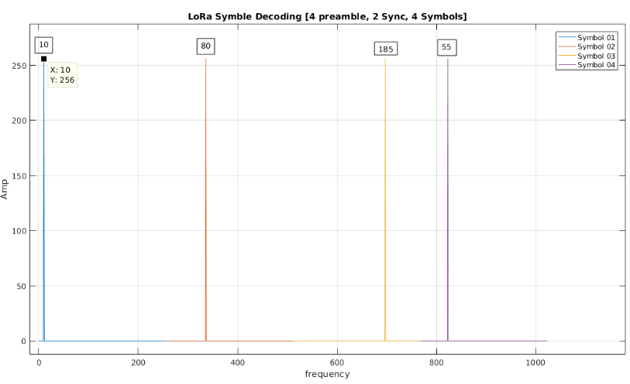
Take FFT of de-chirp signal and check which frequency bin has highest energy.
In the below graph the frequencies having highest energy in a symbol (FFT size 256) represents the data. This way the data can be extracted easily.

Slide 17
LoRaWAN
Low Power, Wide Area Networking (LPWAN) Protocol
Open-standard
Maintained by the LoRa Alliance
Proprietary alternative: Symphony Link
defines device-to-infrastructure parameters and network protocol
Components in star-of-star topology
End-devices , Gateways, Network servers
Gateways as link layer relay only
One-to-one relationship between end-device and network server

Slide 18
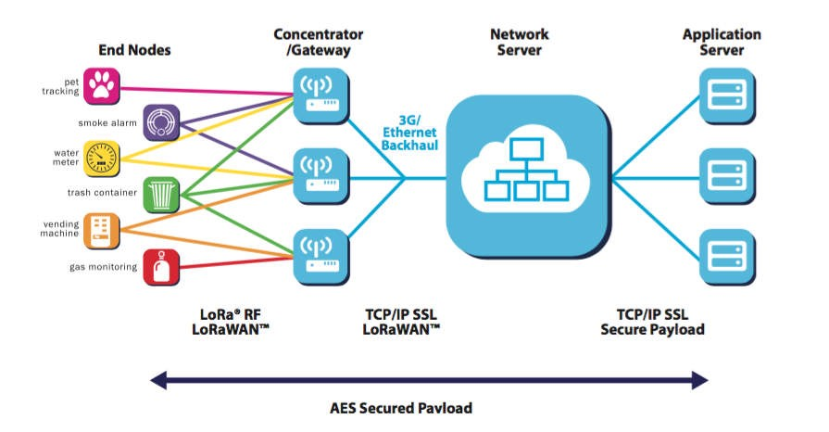
LoRaWAN
Notes:
Image source: https://medium.com/iotforall/your-primer-for-lora-lorawan-33f1e0eb4215

Slide 19
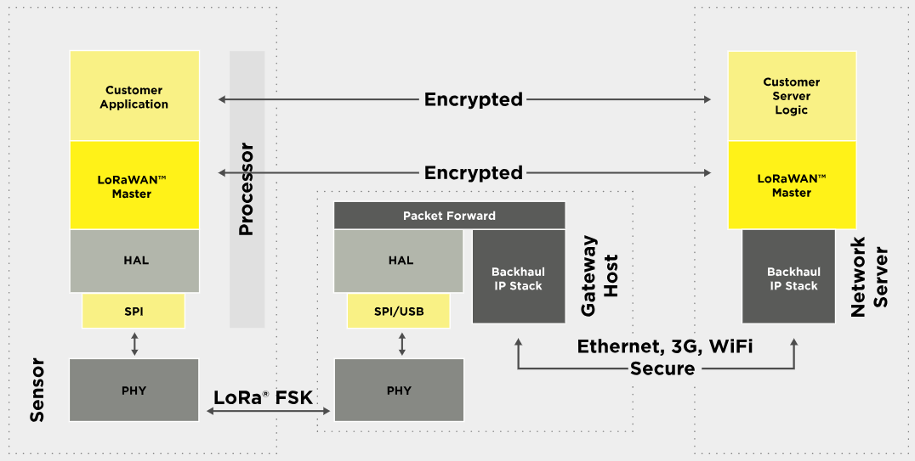
LoRaWAN
Notes:
Image source: https://lora-alliance.https://lora-alliance.org/about-lorawanorg/about-lorawan

Slide 20
LoRaWAN - Device Classes
Class A | Mandatory; Free to schedule uplink subject to constraints; Two downlink windows following uplink; Lowest power consumption; High Downlink Latency;
Class B | Optional; Extends Class A; Beacon-synchronised downlink windows; Deterministic Downlink Latency ;
Class C | Optional; Extends Class C; Always listening, downlink window open whenever not transmitting; Lowest Latency;

Slide 21
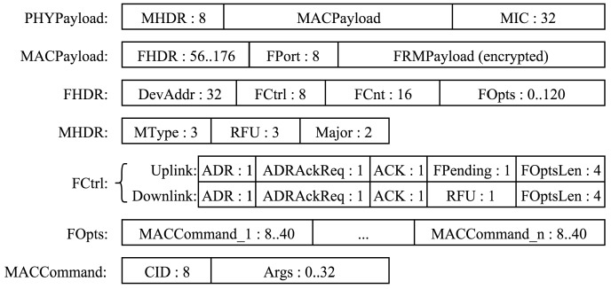
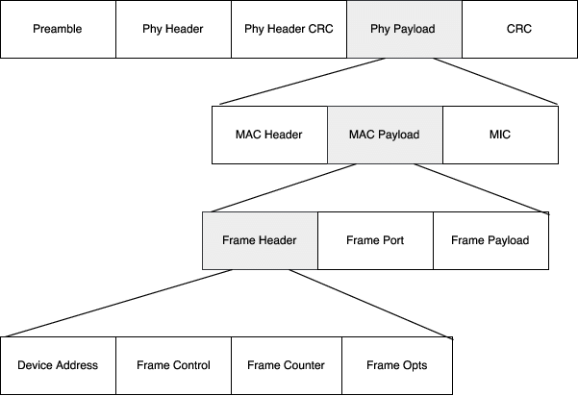
LoRaWAN - Message Format
Notes:
Mac Header: Message Type, LoRaWAN version
MIC: Message Integrity check (uses network session key)
Frame Port: Payload Type, application specific uses case
Frame Payload: AES128 Encrypted (uses app session key)

Slide 22
Development

Slide 23
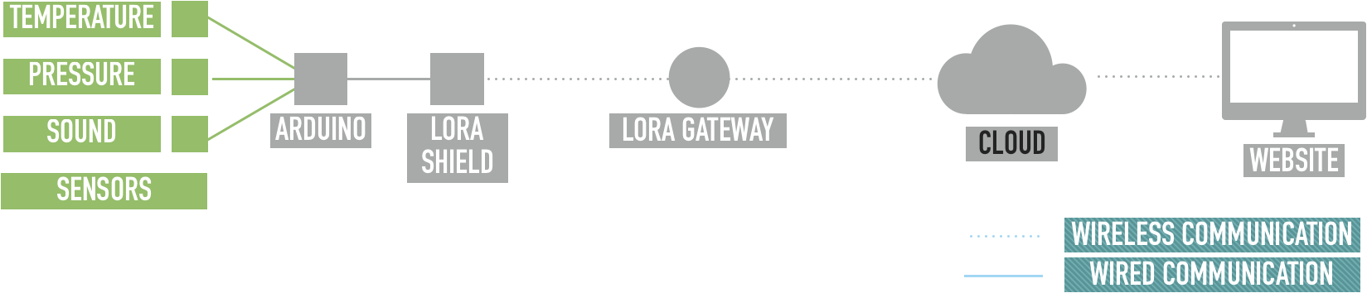
Development: Sensors

Slide 24
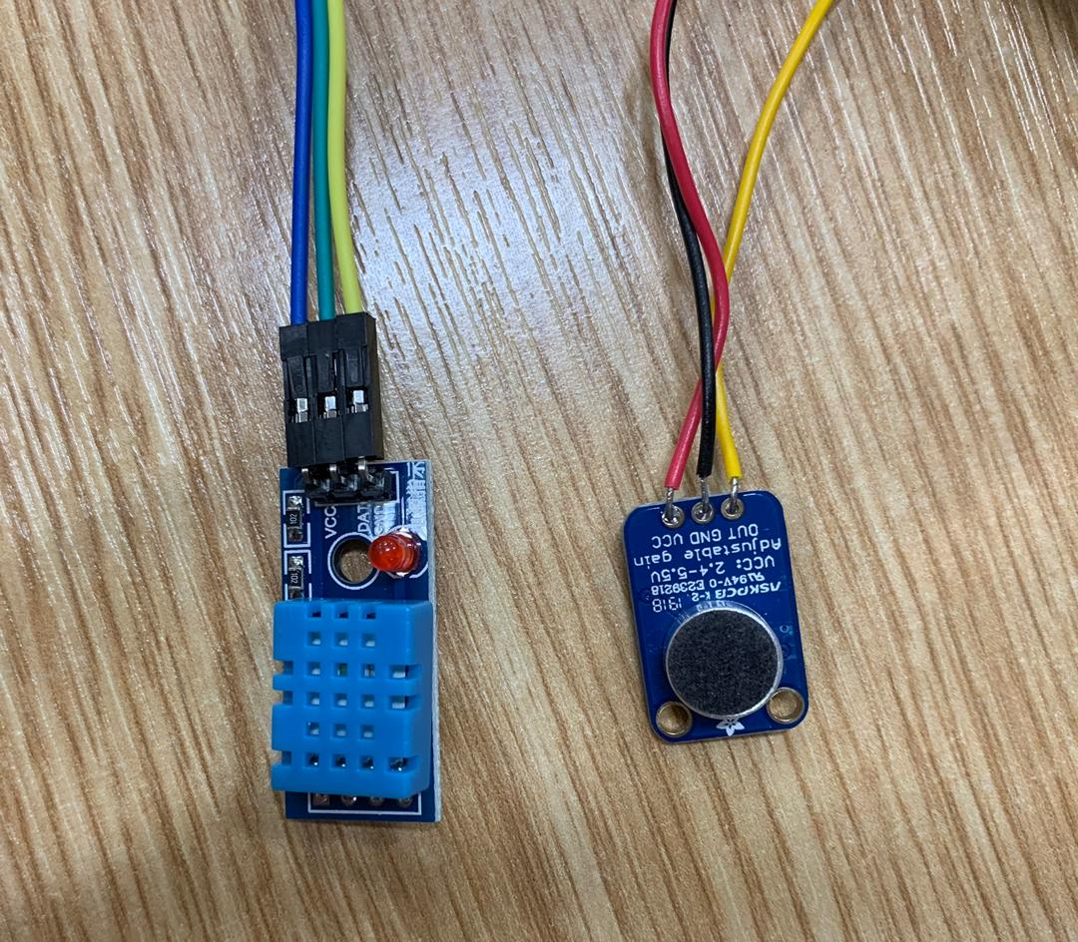
Sensors
DHT11 Humidity & Temperature Sensor
Adafruit 1063 Electret Microphone Amplifier

Slide 25
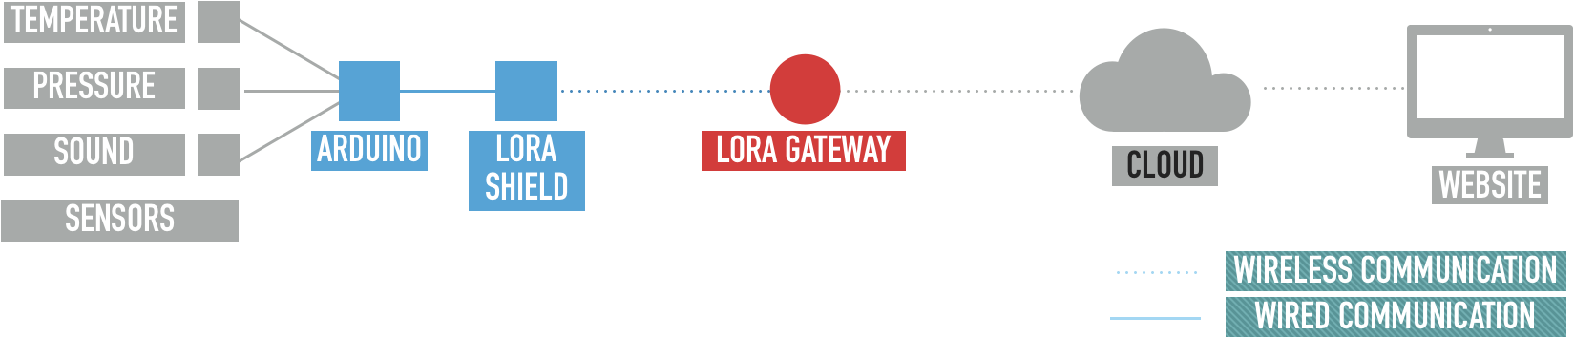
Development: Arduino & LoRa

Slide 26
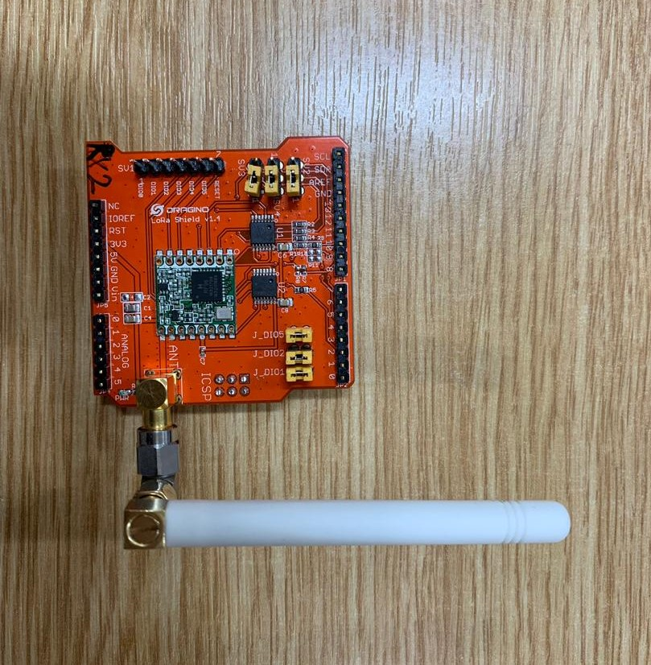
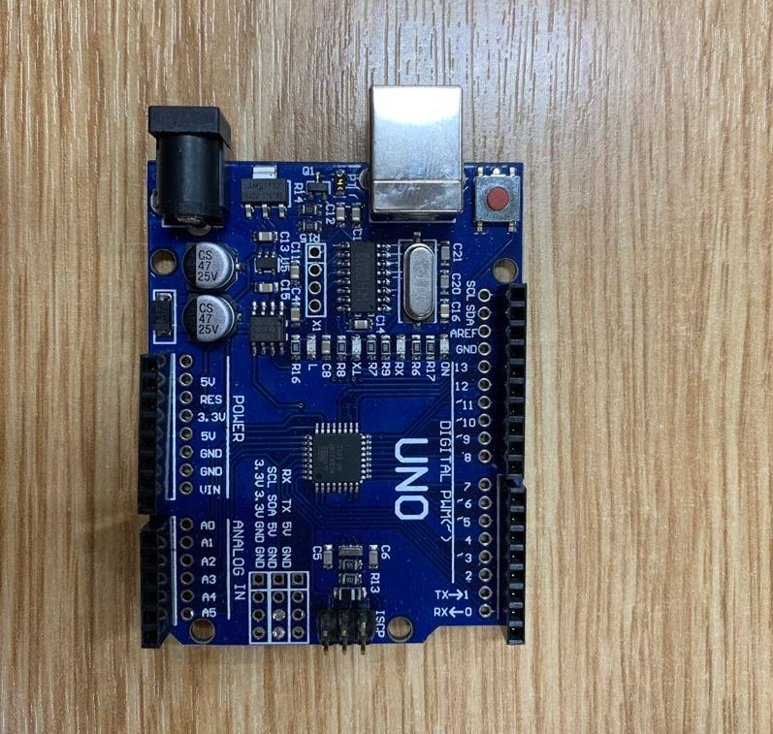
Arduino & LoRa
Dragino LoRa Shield v1.4
UNO Board
Notes:
1. used lmic library from Thomas Telkamp and Matthijs Kooijman
2.

Slide 27
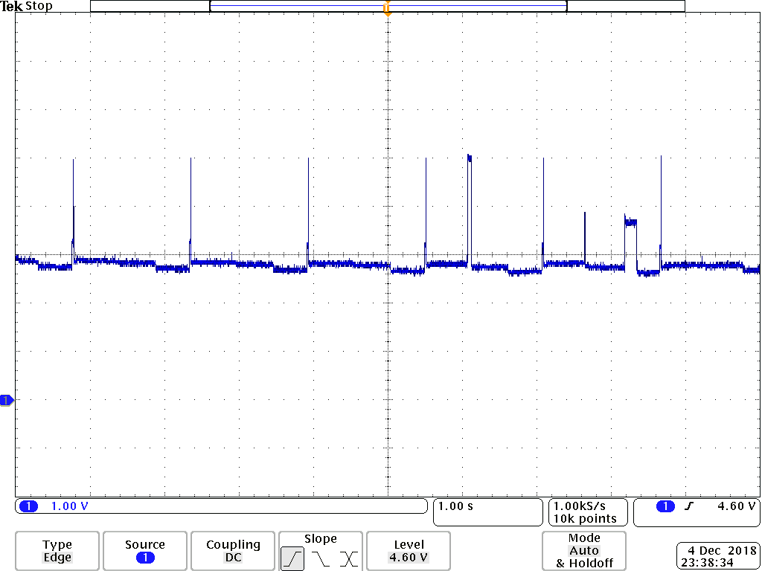
Arduino & LoRa
OS with scheduler
Sensor reading every 1.5 seconds
LoRa transmission every 10 minutes (now 10 seconds)
Use on campus TTN gateways
Network servers by TTN
Device Address - Identification
Network Session Key - MIC
App session Key - AES

Slide 28
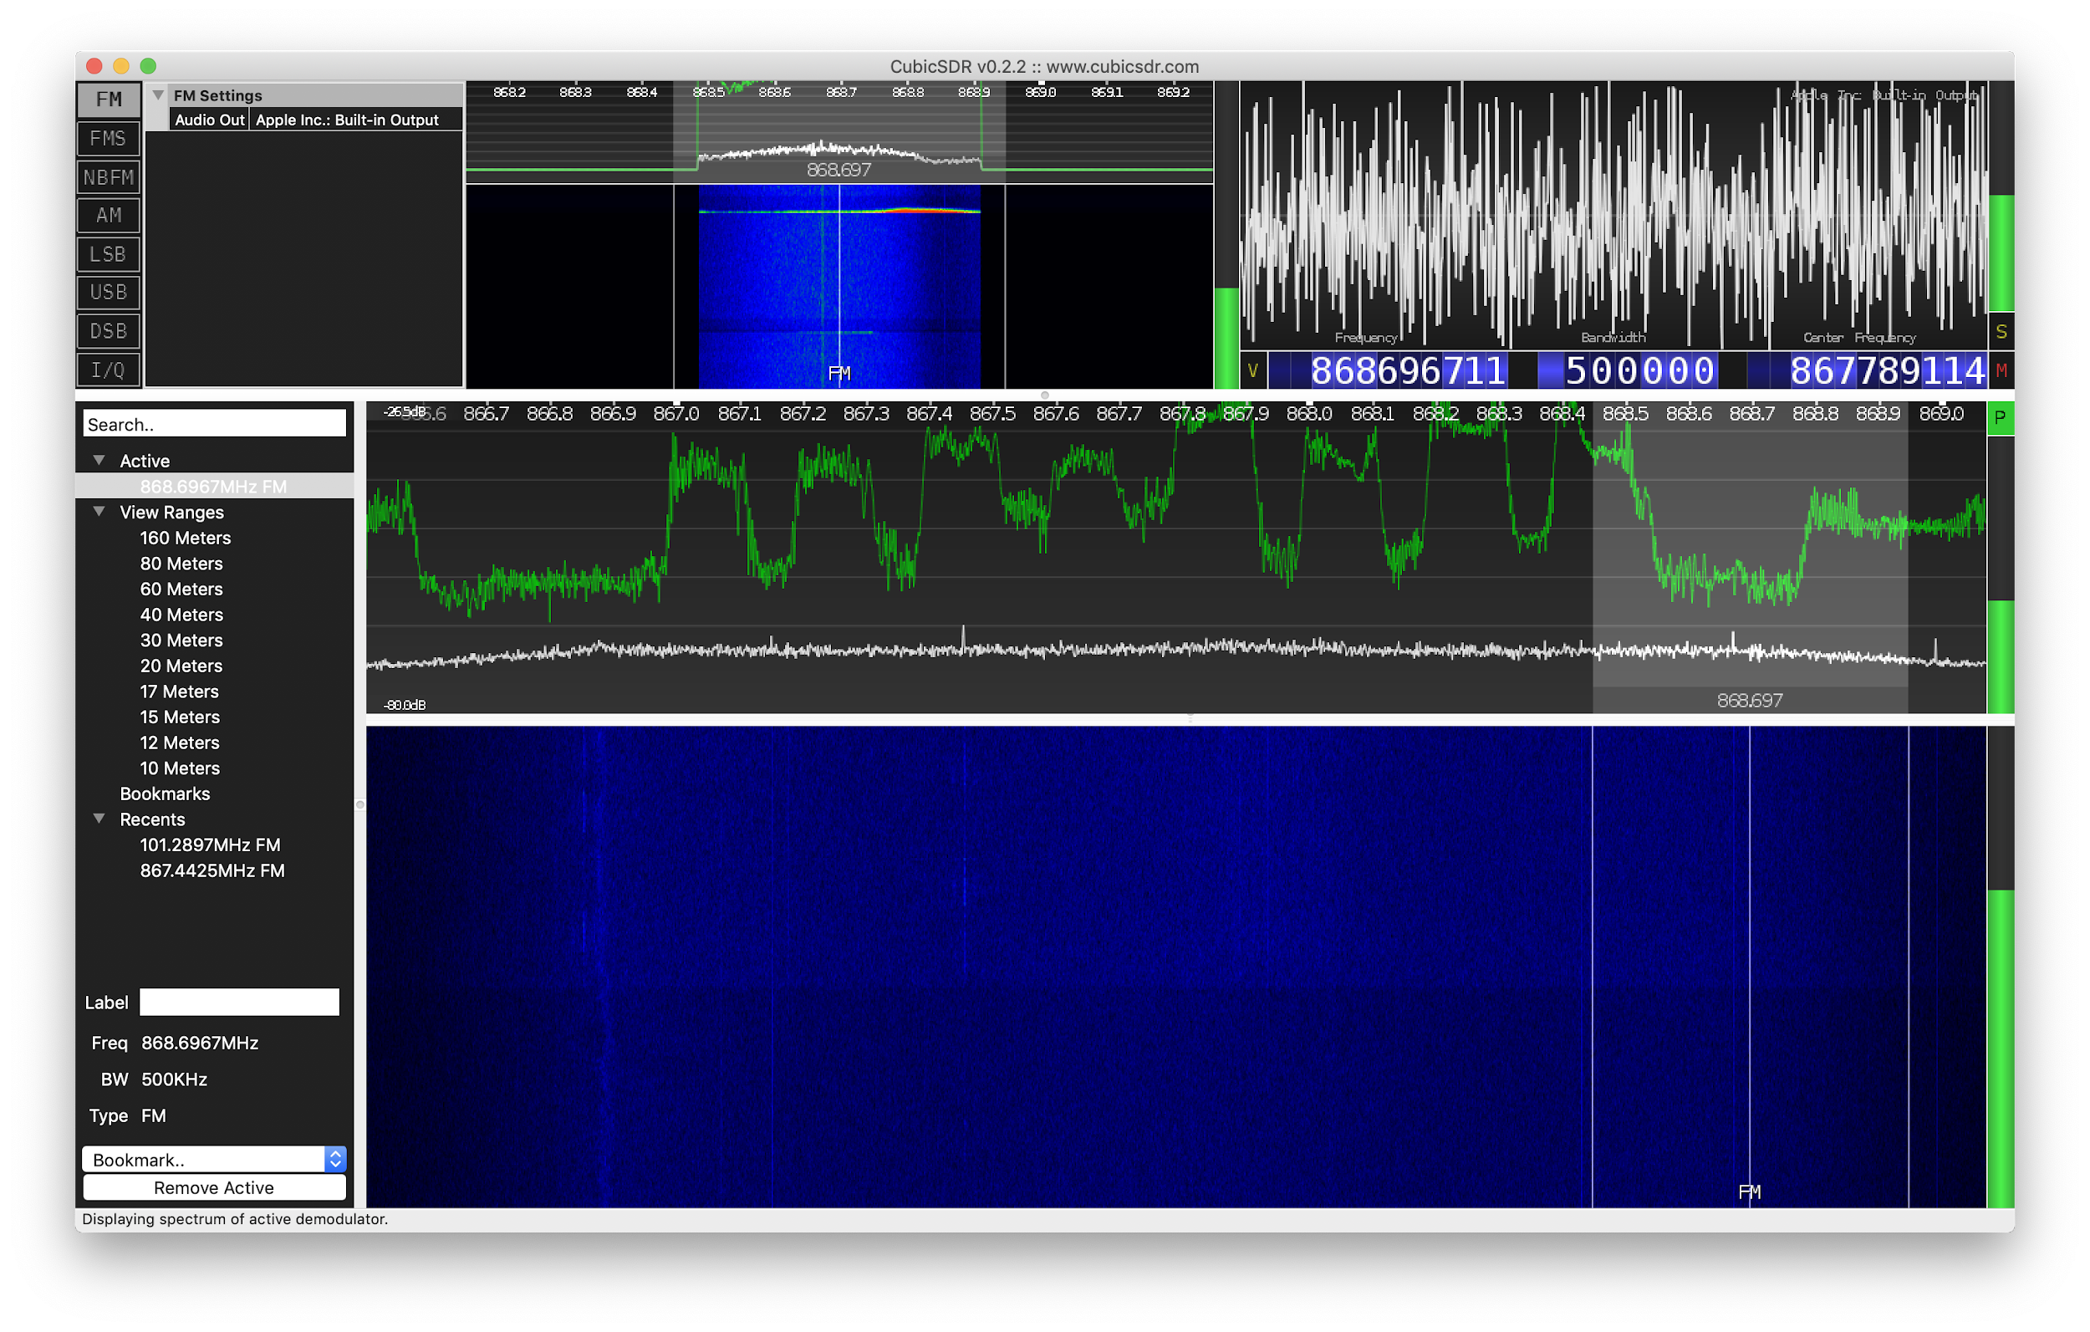
Arduino & LoRa

Slide 29
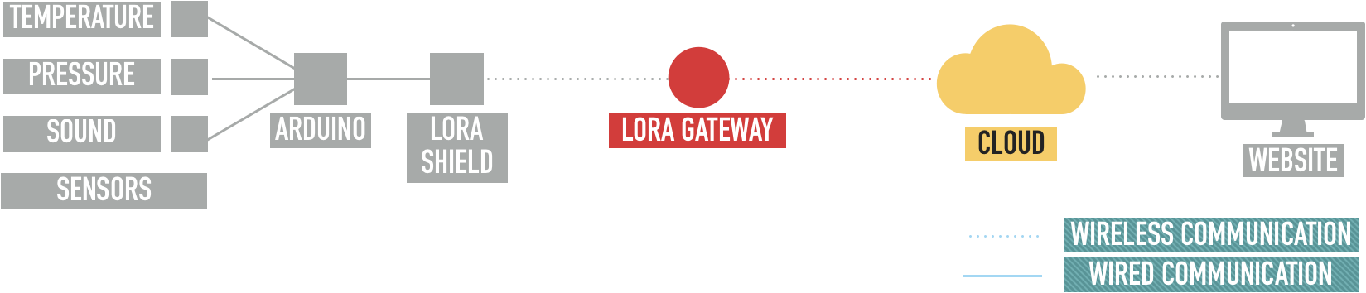
Development: LoRa & Cloud

Slide 30
LoRa & Cloud
LoRa transmissions received by gateways
Data stored in the ‘Console’ of ‘The Things Network’ (TTN)
Send data from TTN Console to Cloud
Cloud service selected was Google’s Firebase
Real-time database
Hosting platform
Notes:
LoRa transmissions are received by gateways in range of the transmission
Data is stored on the things network in the user’s console
Each message sent has an identifier that is unique to the device that sent it - corresponds to a user
From TTN data has to be forwarded to another location so that it can be accessed by the website
For the cloud, firebase was chosen as it provided both the real-time database and the hosting platform for the website
Data could be stored and recalled instantly
Can host the website on the internet through firebase

Slide 31
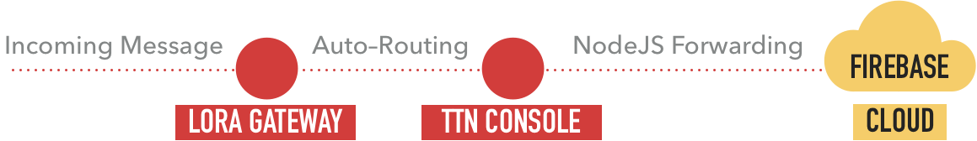
LoRa & Cloud
Each transmission was being routed into the TTN Console
NodeJS was chosen to forward data to Cloud
Simple script to collect new data from the Console and forward to Cloud
Notes:
Each message transmitted from the arduino that reached the gateway is automatically routed by TTN protocols so that it reaches the console of the correct user
This is done via the use of unique access keys for the device as well as the TTN application itself to allow correct routing
From the console to the cloud, nodeJS was used that simply forwarded all the data from the latest transmission and placed it in a new entry in firebase’s Real-time database

Slide 32
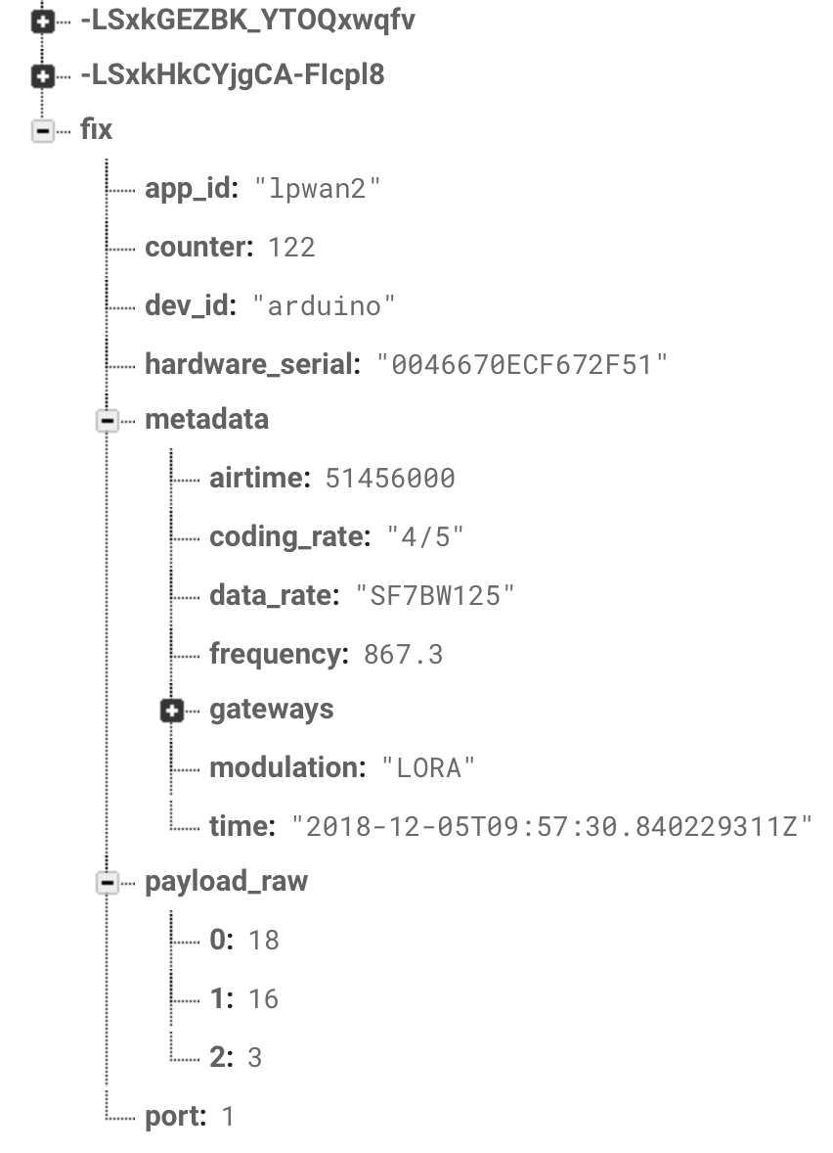
LoRa & Cloud
Data now reaching Firebase
Stored in JSON format
Latest data stored under ‘fix’ branch
Each transmission received contains:
Device that sent data
Timestamp
No. of gateways receiving data
RSSI and SNR
Payload
Screenshot from Firebase
Notes:
Data now reaching firebase as shown here
Data is stored in JSON format - simple tree structure simple for accessing data from the website in JS
New data placed under the ‘fix’ branch for a fixed location in database at all time
On new data arriving, old data is moved to a unique identifier branch so that it isn’t lost
A large amount of data is received by the gateway, not just the payload(_raw)
0 is Temp
1 is Pressure
2 is Sound

Slide 33
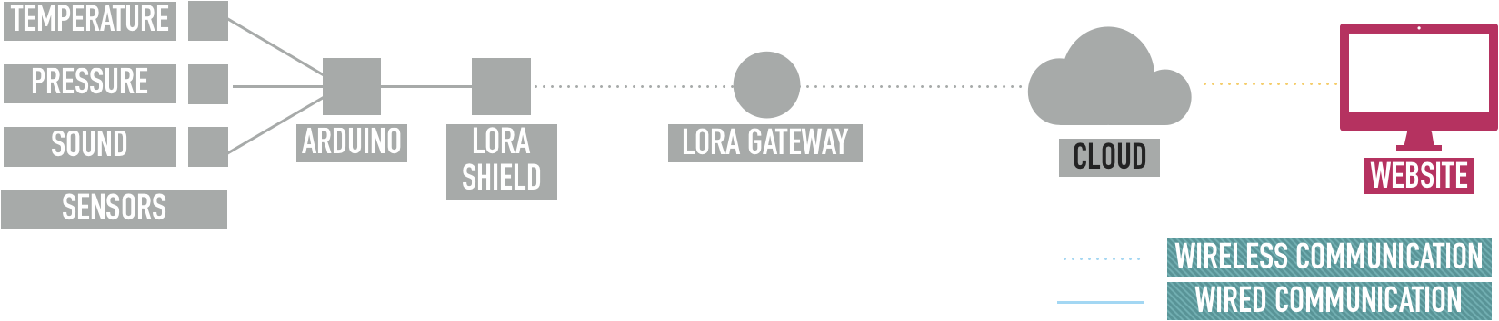
Development: Website

Slide 34
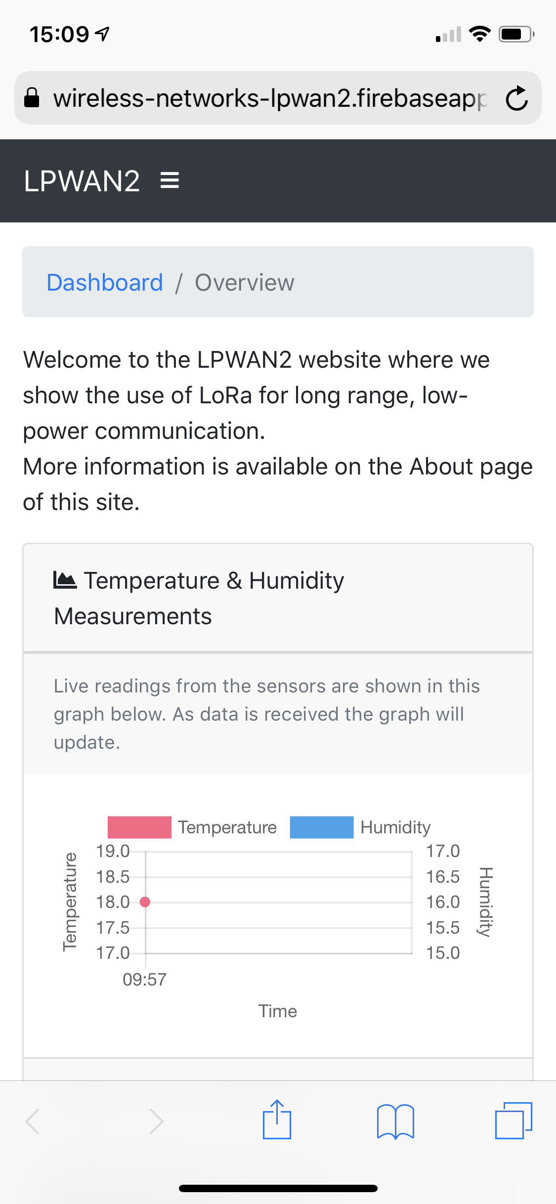
Website
Designed using Bootstrap
Combination of HTML, CSS and JavaScript
Using JavaScript to read/write from Firebase
Responsive design for use on devices of all screen sizes
Mobile
Notes:
Website was designed as a static site using Bootstrap
Combination of HTML, CSS and JS gives the basic structure required
JavaScript library gives access to firebase from the website
Designed to be responsive so that it works across mobiles, tablets and desktops

Slide 35
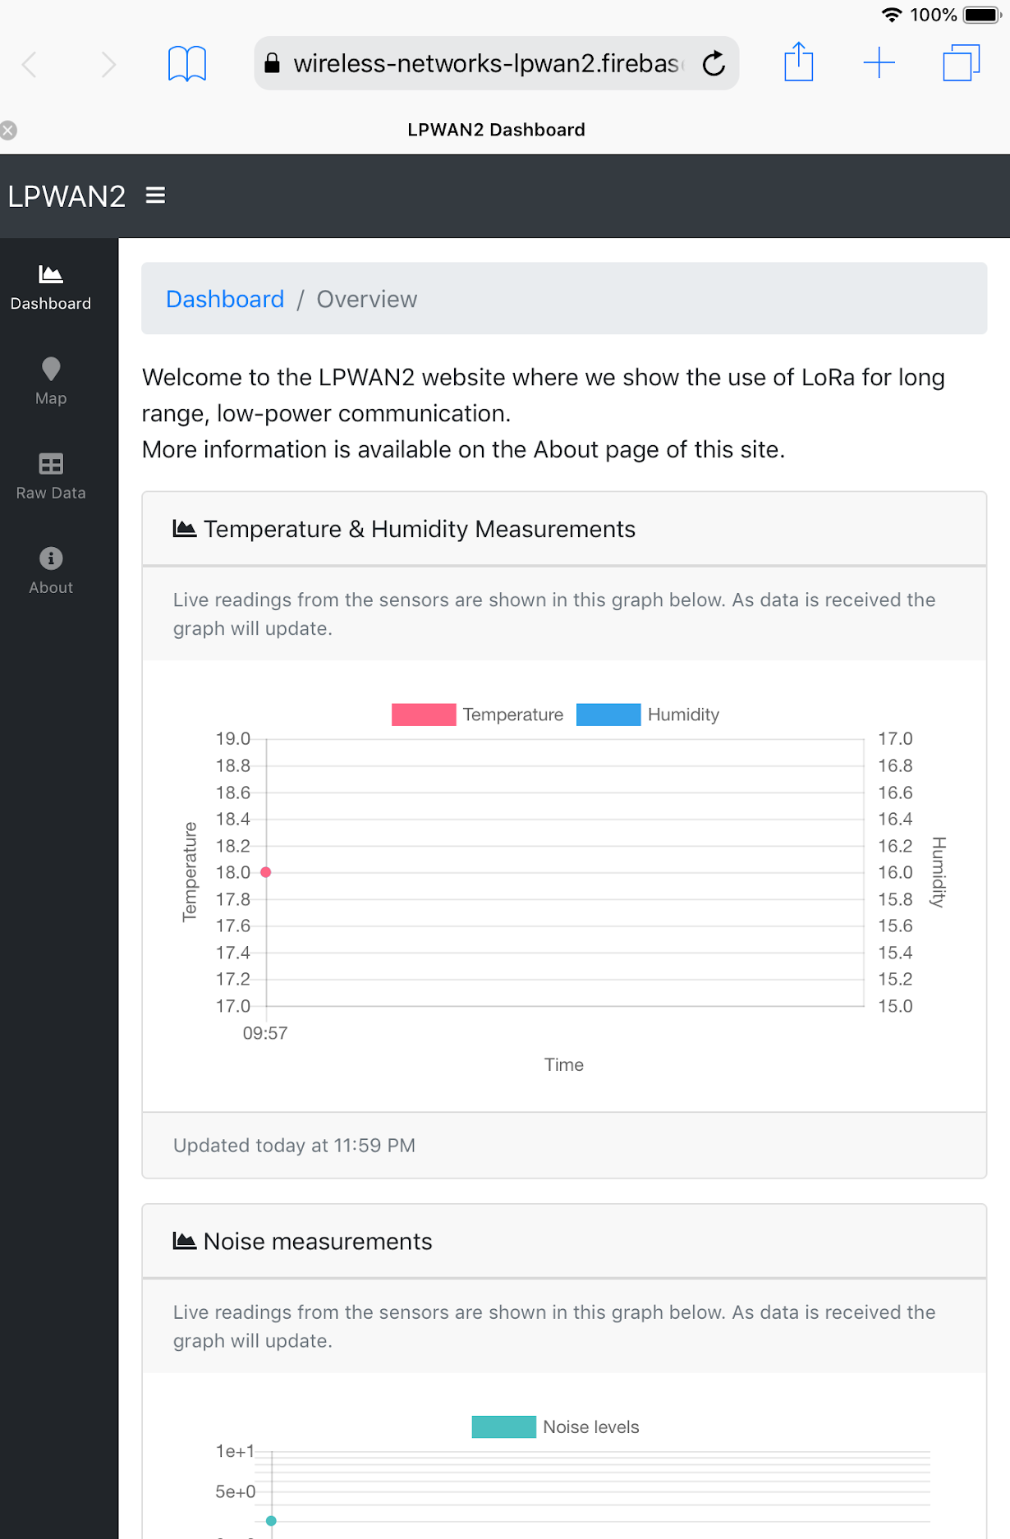
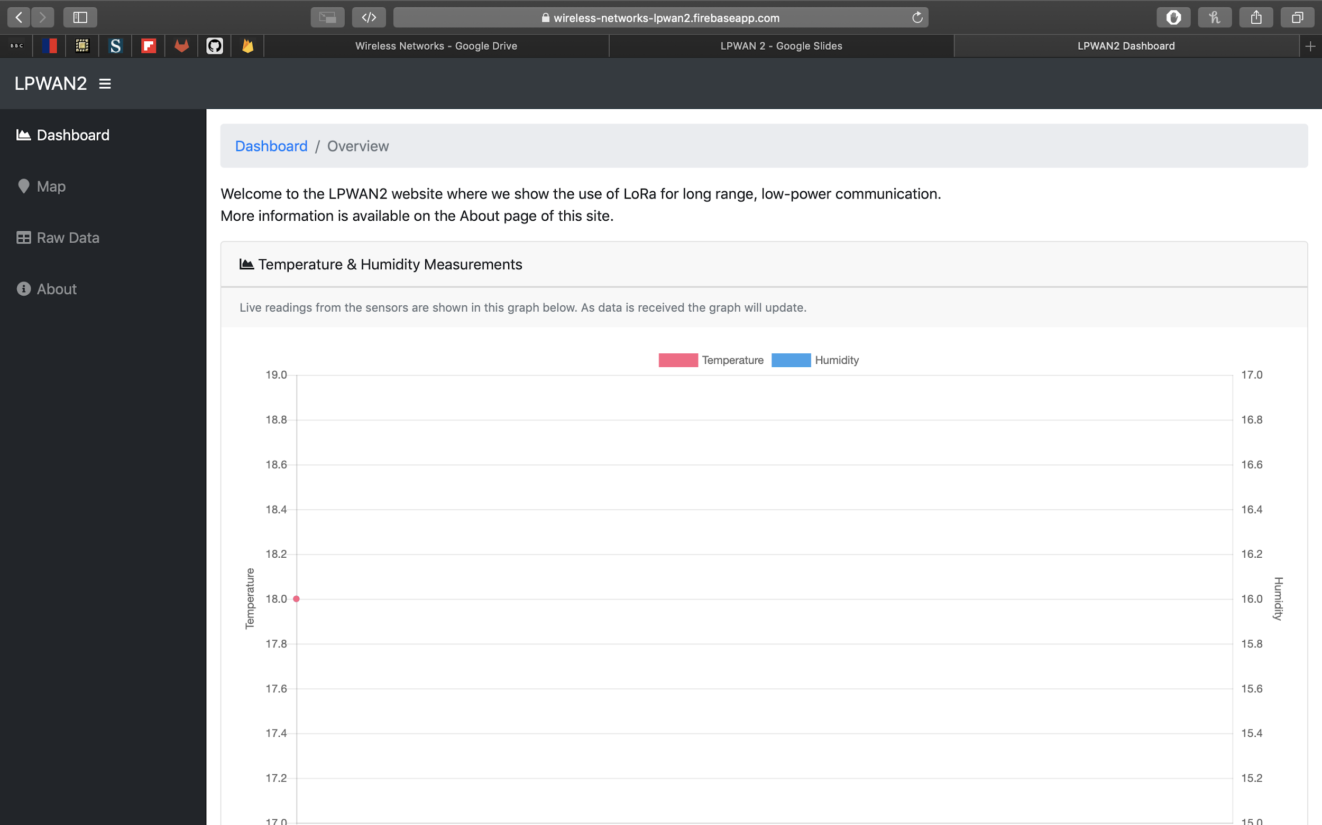
Desktop
Tablet

Slide 36
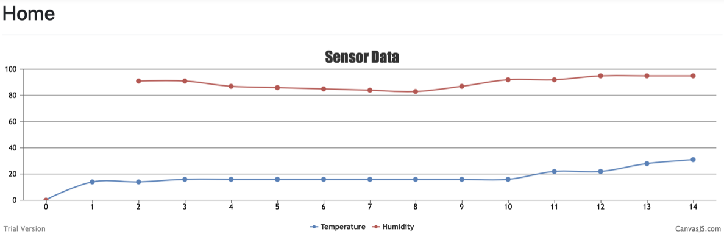
Website
Data is visualised through the use of charts and maps
The raw payloads are also available through the site
Dynamic data rendering using angularJS
Live data being streamed on the website as new readings become available
Notes:
Data is visualised through various types of chart and through google maps as well
The raw payload is also displayed on one page of the website
JavaScript means that as soon as the nodeJS script forwards the data to firebase, the changes are reflected on the website

Slide 37
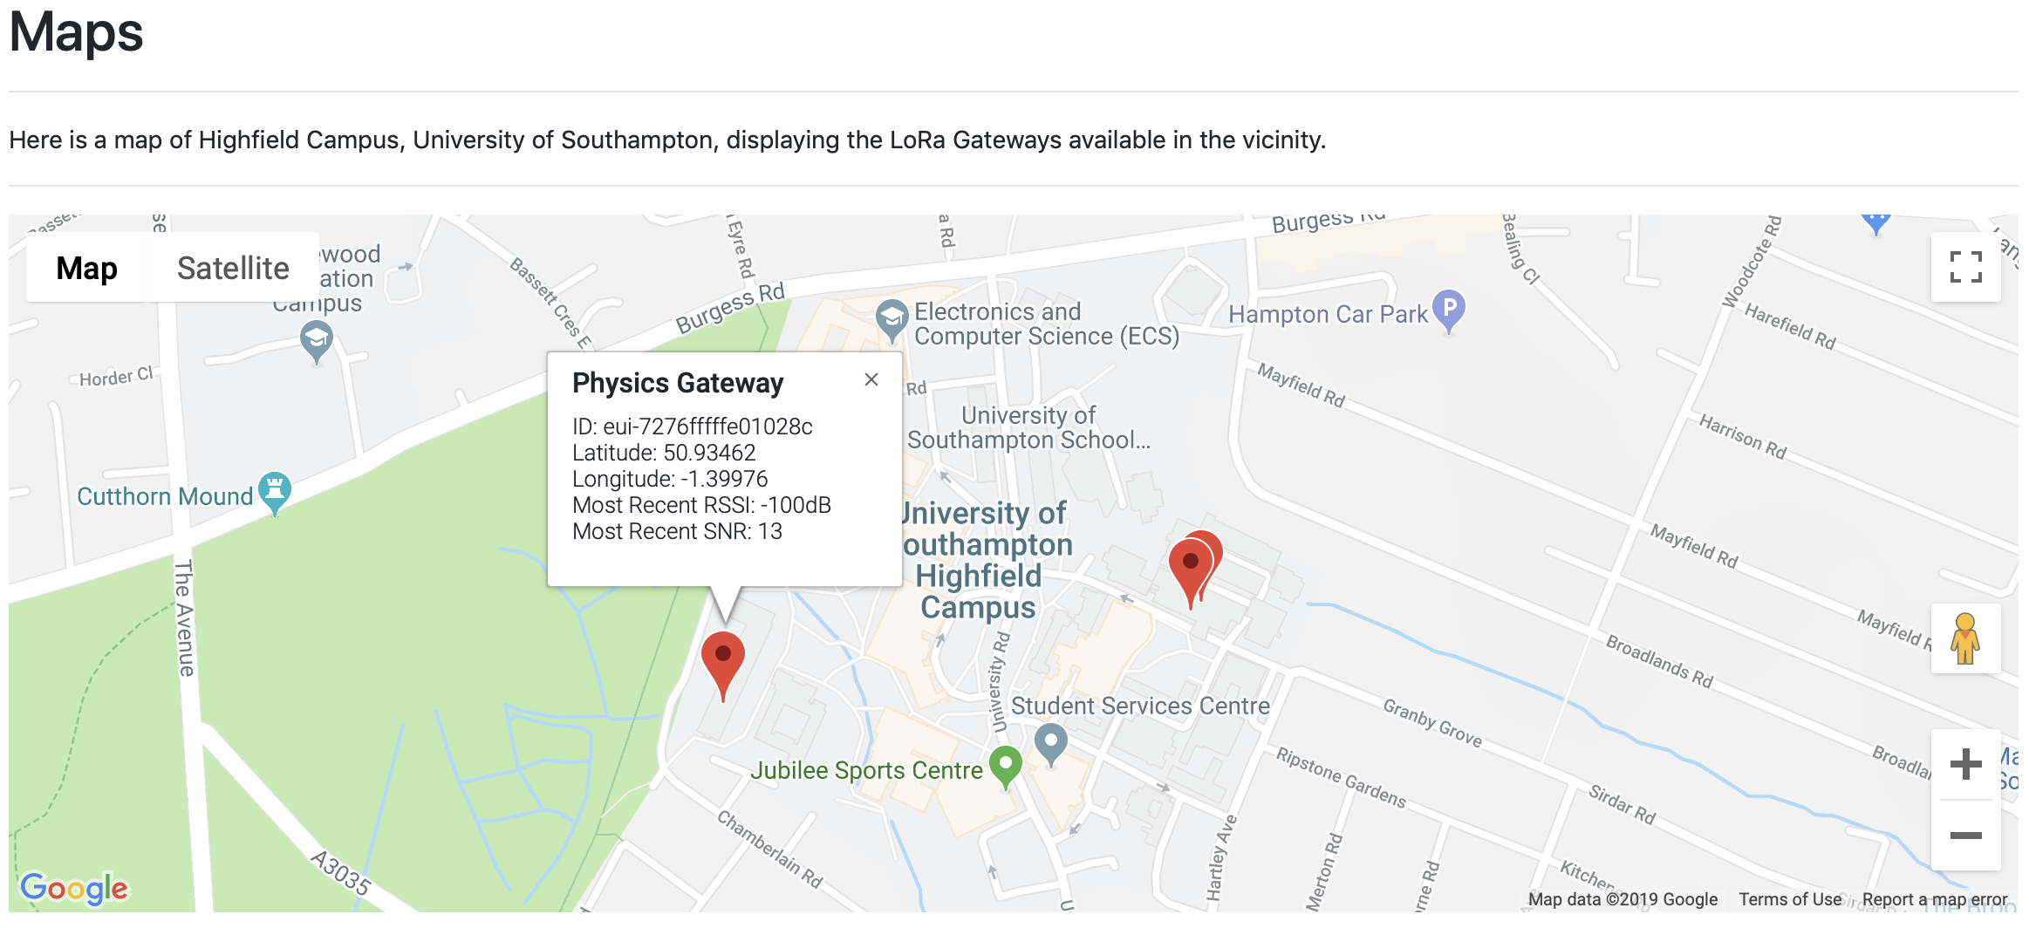
Google Maps embedded in the website showing gateways where data has been received

Slide 38
Testing
Testing had three focal points:
Test of transmission reliability in different environments
Compare transmission reliability of different spreading factors
Test different Gateway antennas
During testing two devices were used at each transmission location
Identical except for the spreading factor used
One used SF7, the other SF12
SF12 should be received for a greater distance than SF7 due to the duration of transmission
Notes:
The testing for this project was in two parts:
To test reliability of LoRa transmissions in various different environments
To compare reliability when using different spreading factors
Test different gateway antennas (building 7 had a Kerlink and a DIY Raspberry Pi gateway -- these were used for testing)
During tests two identical devices were used with the only differences being the spreading factors used for transmissions.
One device used SF7 while the other used SF12.
In theory, the spreading factors vary the distance over which a transmission is received and therefore a higher spreading factor (SF12) should be received more readily than SF7, and for larger distances from a gateway.

Slide 39
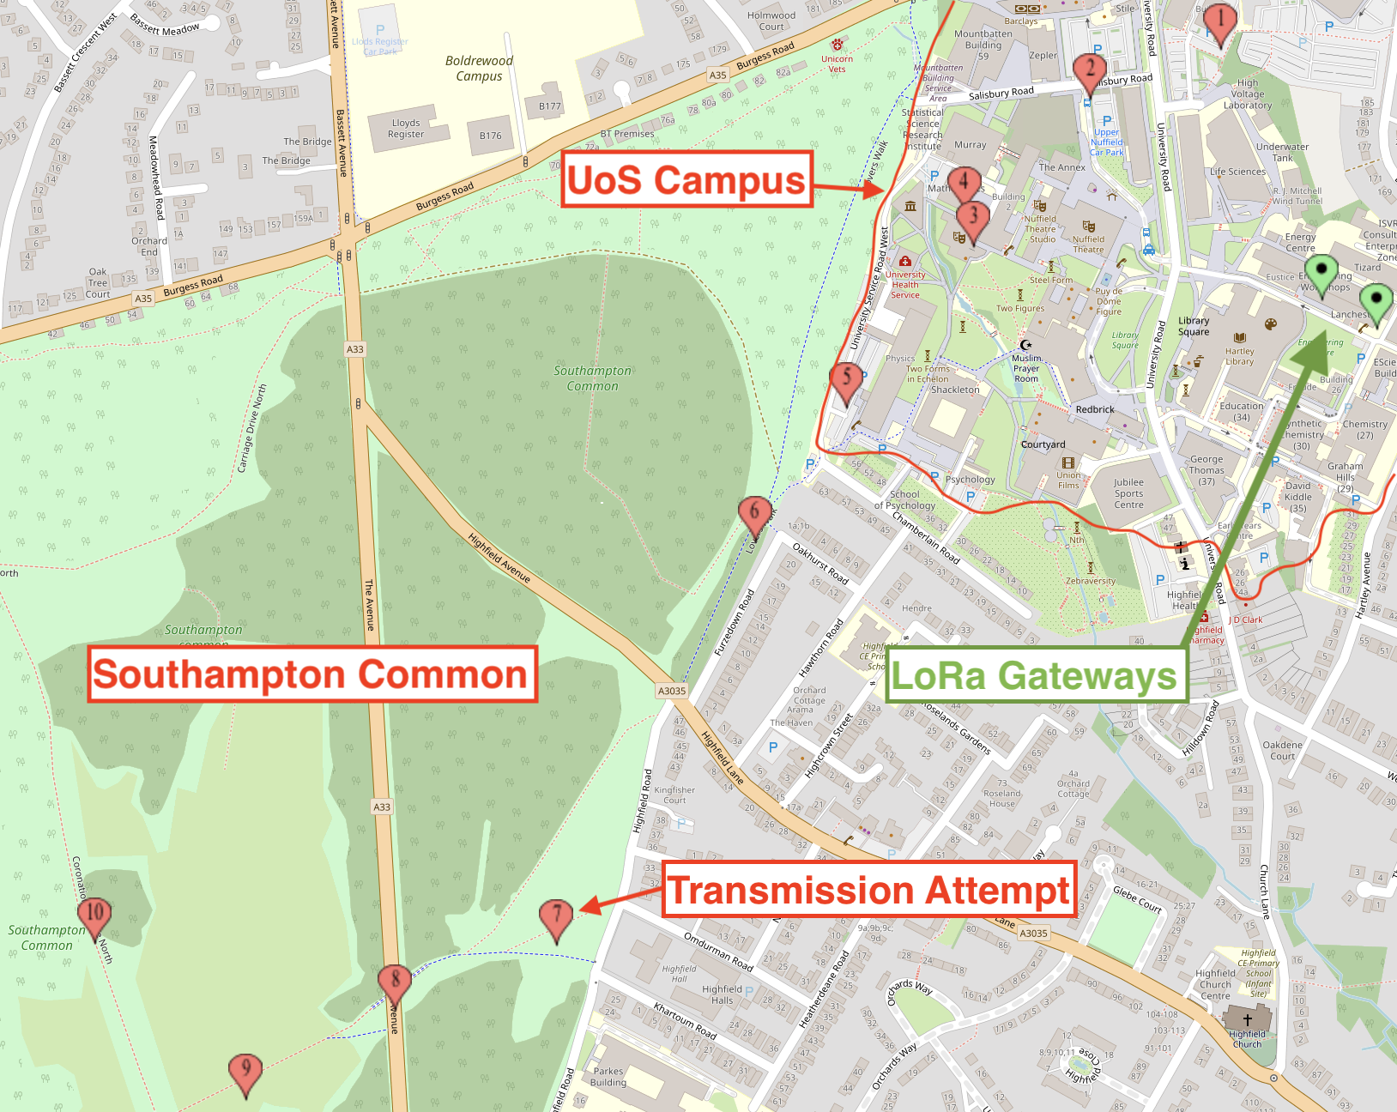
Testing: Locations
Environments used:
Line-of-sight of gateway antenna
Surrounded by multi-storey buildings
Underground (subway)
Open planes
Densely populated area of trees
Notes:
The variation of location potion let us analyse qualitative the robustnes of the implemented system

Slide 40
Testing
At each location for transmission these events occurred:
One transmission using SF7
One transmission using SF12
RSSI and SNR values recorded from Console on TTN
Measurements for the two Gateways on Building 7 were taken
Notes:
SF = Spreading Factor
RSSI = Received Signal Strength Indication
SNR = Signal to Noise Ratio

Slide 41
Testing: Results
Results show variations in signal strength due to various factors
General Trends:
RSSI dropped with distance
SNR dropped to lowest values due to environment (buildings, trees etc.)
SF7 failed to send a message from Southampton Common when amongst trees
Signals received by the DIY Raspberry Pi gateway were lower strength than those on the multi-channel Kerlink gateway
Notes:
General trends:
RSSI dropped from around -80dB to approximately -115dB for both SF7 and SF12 in different environments
(SNR is measured according to a base level determined by TTN) Values ranged from +15 in open space, to 0 for dense trees, to -10 underground
When in amongst a lot of trees on Southampton Common, SF7 failed to send messages to the gateways on the University campus, whereas SF12 still succeeded. This is expected due to the longer transmission ‘chirp’ that SF12 uses.
The DIY raspberry Pi gateway received transmissions at lower RSSI values than the Kerlink branded gateway. Often ~10dB difference between the two gateways in received signal strength.
>>> End slide by saying: “We shall do a demonstration of the system and answer any questions”

Slide 42
Demonstration & Questions
Website: https://wireless-networks-lpwan2.firebaseapp.com

